Slide 1
Geography intro. notes
Standard foundations
Mrs. sullivan

Slide 2
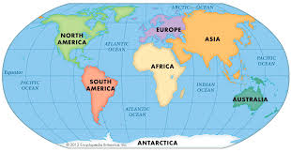
continent
ONE OF THE SEVEN LARGEST LANDMASSES

Slide 3
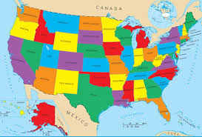
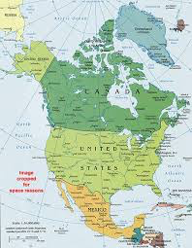
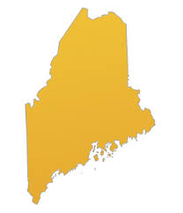
COUNTRY
A POLITICAL REGION WITHIN A CONTINENT

Slide 4
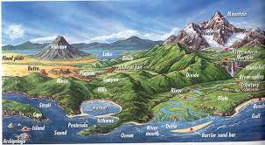
LANDFORM
A NATURAL FEATURE ON THE EARTH’S SURFACE

Slide 5
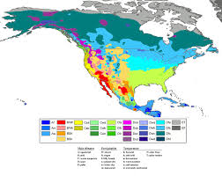
CLIMATE
PATTERN OF WEATHER IN A REGION OVER A YEAR

Slide 6
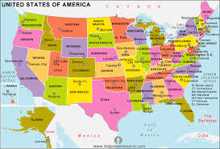
POLITICAL MAP
SHOWS COUNTRIES, STATES, AND OTHER POLITICAL DIVISIONS

Slide 7
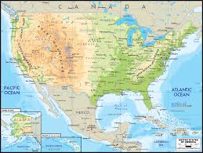
PHYSICAL MAP
SHOWS LANDFORMS

Slide 8
COMPASS ROSE

Slide 9
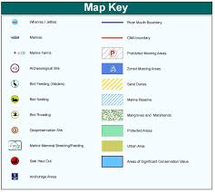
LEGEND/KEY
EXPLANATION OF A MAPS SYMBOLS AND COLORS

Slide 10
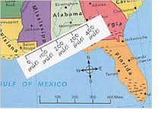
SCALE
MEASURES THE ACTUAL DISTANCE BETWEEN TWO PLACES ON A MAP

Slide 11
LATITUDE
MEASURES THE DISTANCE NORTH AND SOUTH OF THE EQUATOR
EQUATOR – IMAGINARY LINE THAT DIVIDES EARTH INTO NORTHERN AND SOUTHERN HEMISPHERS

Slide 12
LONGITUDE
MEASURES THE DISTANCE EAST AND WEST OF THE PRIME MERIDIAN
PRIME MERIDIAN – IMAGINARY LINE THAT DIVIDES THE EARTH INTO EASTERN AND WESTERN HEMISPHERES

Slide 13
ABSOLUTE LOCATION
ACTUAL LOCATION USING A SET OF COORDINATES

Slide 14
RELATIVE LOCATION
USING OTHER “LANDMARKS” TO LOCATE A PLACE

Slide 15
URBAN, SUBURBAN, AND RURAL
URBAN
SUBURBAN
RURAL

Slide 16
MAPPING SYMBOLS

